Slide 1
Big Mountain Resort
New chair lift cost recoup project
By
Tom Cheng

Slide 2
Problem Identification
Big Mountain Resort has recently installed additional chair lift, which increased the operating costs by $1,540,000 this season.
The goal of this project is to find a solution to maintain business profit margin at 9.2% after the addition of the new chair lift.

Slide 3
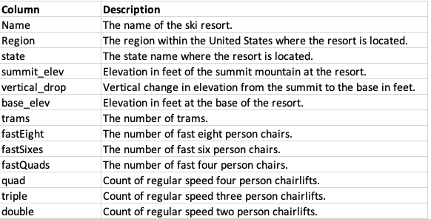
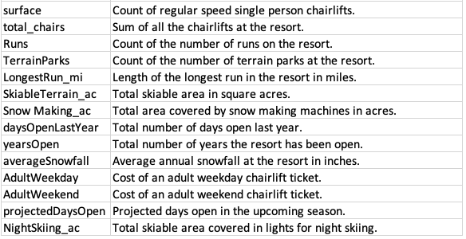
Modeling and Analysis
The data provided contains the following information
Across a total of 266 resorts across U.S. in the data (after filtering out the outliers).

Slide 4
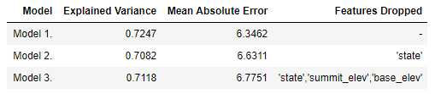
Modeling and Analysis
3 Linear Regression Prediction Models were implemented. Model 1 had the lowest Mean Absolute Error while contained all the variables, and thus was chosen because it is plausible that different states will effect ski resorts’ ticket prices.

Slide 5
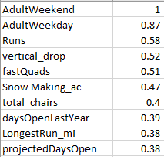
Modeling and Analysis
This is the top 10 correlation coefficient table with the named variable to Adult Weekend ticket price.
A scatter plot of the following variables by adult weekend ticket price were done for analysis: Runs, vertical_drop, fastQuads, total_chairs, LongestRun_mi.
AdultWeekday was ignored b/c we have same ticket prices for weekday/weekends.
Snow making was ignored, because it’s snow is made only when necessary.
Days opened last year was ignored because most of the resorts opened for 120 days, and we opened 123 days, which is right were most of the resorts were at.

Slide 6
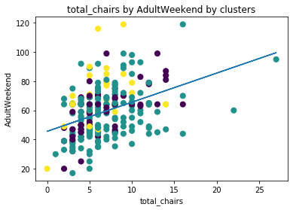
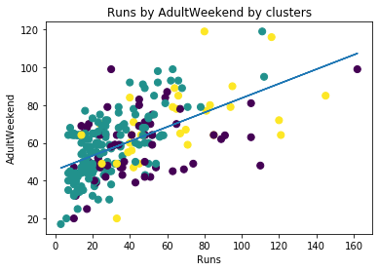
Modeling and Analysis
From this graph, we can see that resorts with more chair lifts is likely to have higher ticket price. And we currently have the lowest ticket price for resorts with similar summit elevation and chair lifts.
From this graph, we can see that resorts with more runs also tend to have higher ticket price. And Big Mountain Resort, currently has its ticket price below the regression line.

Slide 7
Recommendation and Key Findings
Since majority of the resorts had total of 120 open days, and it doesn’t have much correlation to ticket prices, I will recommend to continue the operating days to be around that number like last season, which had 123 days.
The linear regression model estimated Big Mountain Resort’s Adult Weekend ticket price to be $86.
A 5% increase due to inflation is acceptable, so we should add 5% of $81 to the estimated $86 and round it to the nearest dollar, which is $90. And since we had weekday/weekend ticket price to be the same, both should be increased to $90.

Slide 8
Summary and Conclusion
Even though the top correlation variables by adult weekend plots’ regression line has shown Big Mountain Resort to have higher weekend ticket price than the regression line for 4 of the plots. When all other information were taken into account, the model estimated the weekend ticket price to be $86.
The linear regression model used had a standard deviation of 17.26, while the model’s mean Adult Weekend ticket price is 59.35. The recommendation of $90 is still within 2 standard deviation, and thus, an acceptable range.

